Slide 1
Hard-won Progress: a discussion with WynePay DFSP participants
Panel Discussion
25-Oct-2022

Slide 2







WynePay powered by Mojaloop technology
Let’s Pay Together (in Burmese)
Interoperable
Open Platform
Low cost
Locally operated
Participant-owned and governed

Slide 3

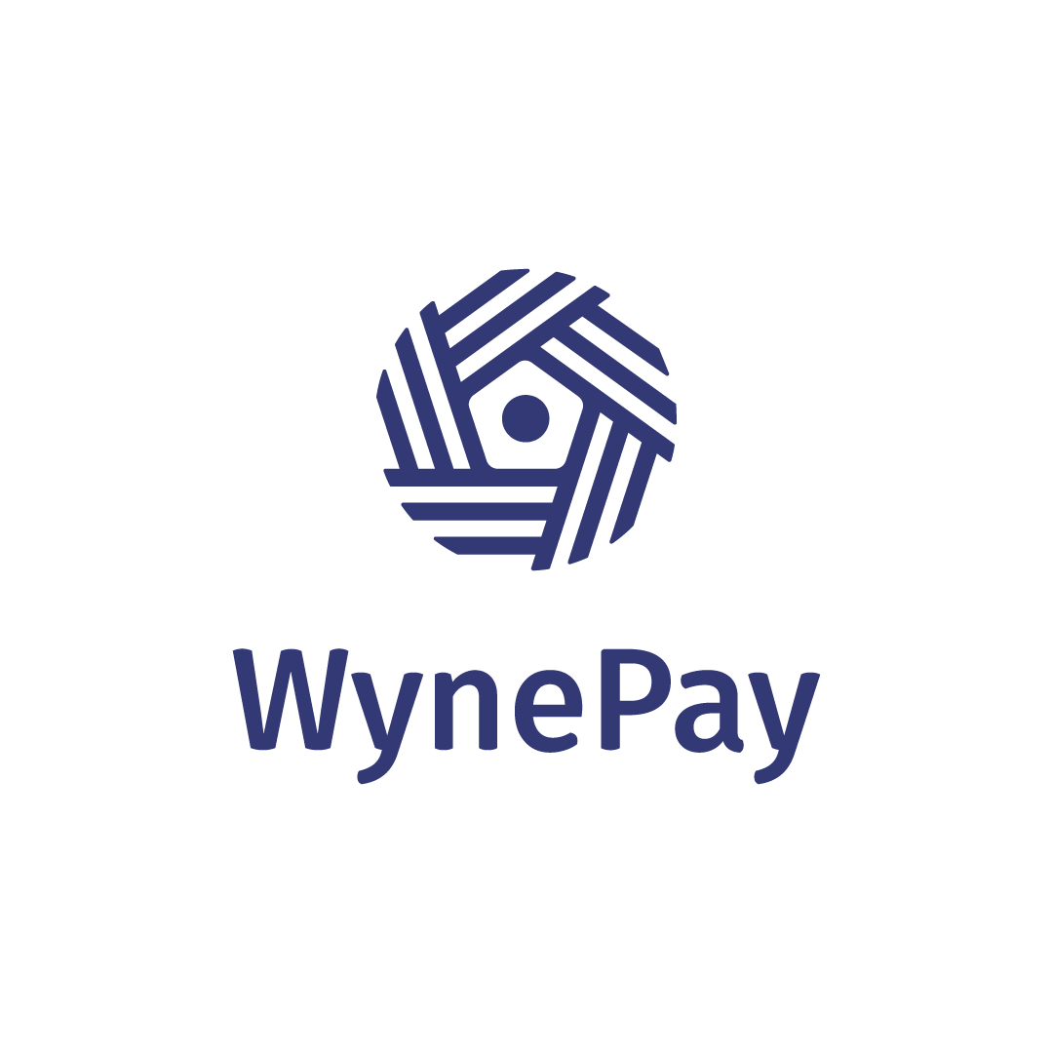
Key milestones / the journey so far
Governance structures (Scheme Council, Scheme Advisory, Technical Working Groups)
Mojaloop PoC Lab
DFSPs participation and integration process
1
2
3
Settlement bank and processes
MVP under a
phased rollout
(FUT 1.0 – FUT 2.0 – CUG)
Localized Hub operations
Scheme rules, including pricing and participation rules
4
We are here!
7
6
5
Regulatory compliance and approvals and commercial agreements
8
Driving the business case through adoption and expansion
WP connects to the national payment system
WynePay Service under an existing banking license
WynePay Scheme as a members-led LGC
9
10
10
11
12

Slide 4
Panel Discussion
Facilitator
Mr. Amit Kumar Garg
Speaker 1 : Mr. Sai Nay Lynn (Hana Microfinance)
Speaker 2 : Mr. Kaung Set Lin (MIFIDA)
Speaker 3 : Ms. Su Mon Aung (ThitsaWorks)

